Slide 1
A high-speed MTCA.4-based digitizer for the LLRF control system of the J-PARC MR
01/15
Yasuyuki SUGIYAMA
KEK/J-PARC
2025/Oct./16th(Thu)
LLRF workshop 2025@Newport News Marriott at City Center/JLAB

Slide 2
Outline
02/15
Introduction of J-PARC and MR
Requirement for the high-speed digitizer
MTCA.4-based high-speed digitizer
Future Prospect
Summary

Slide 3




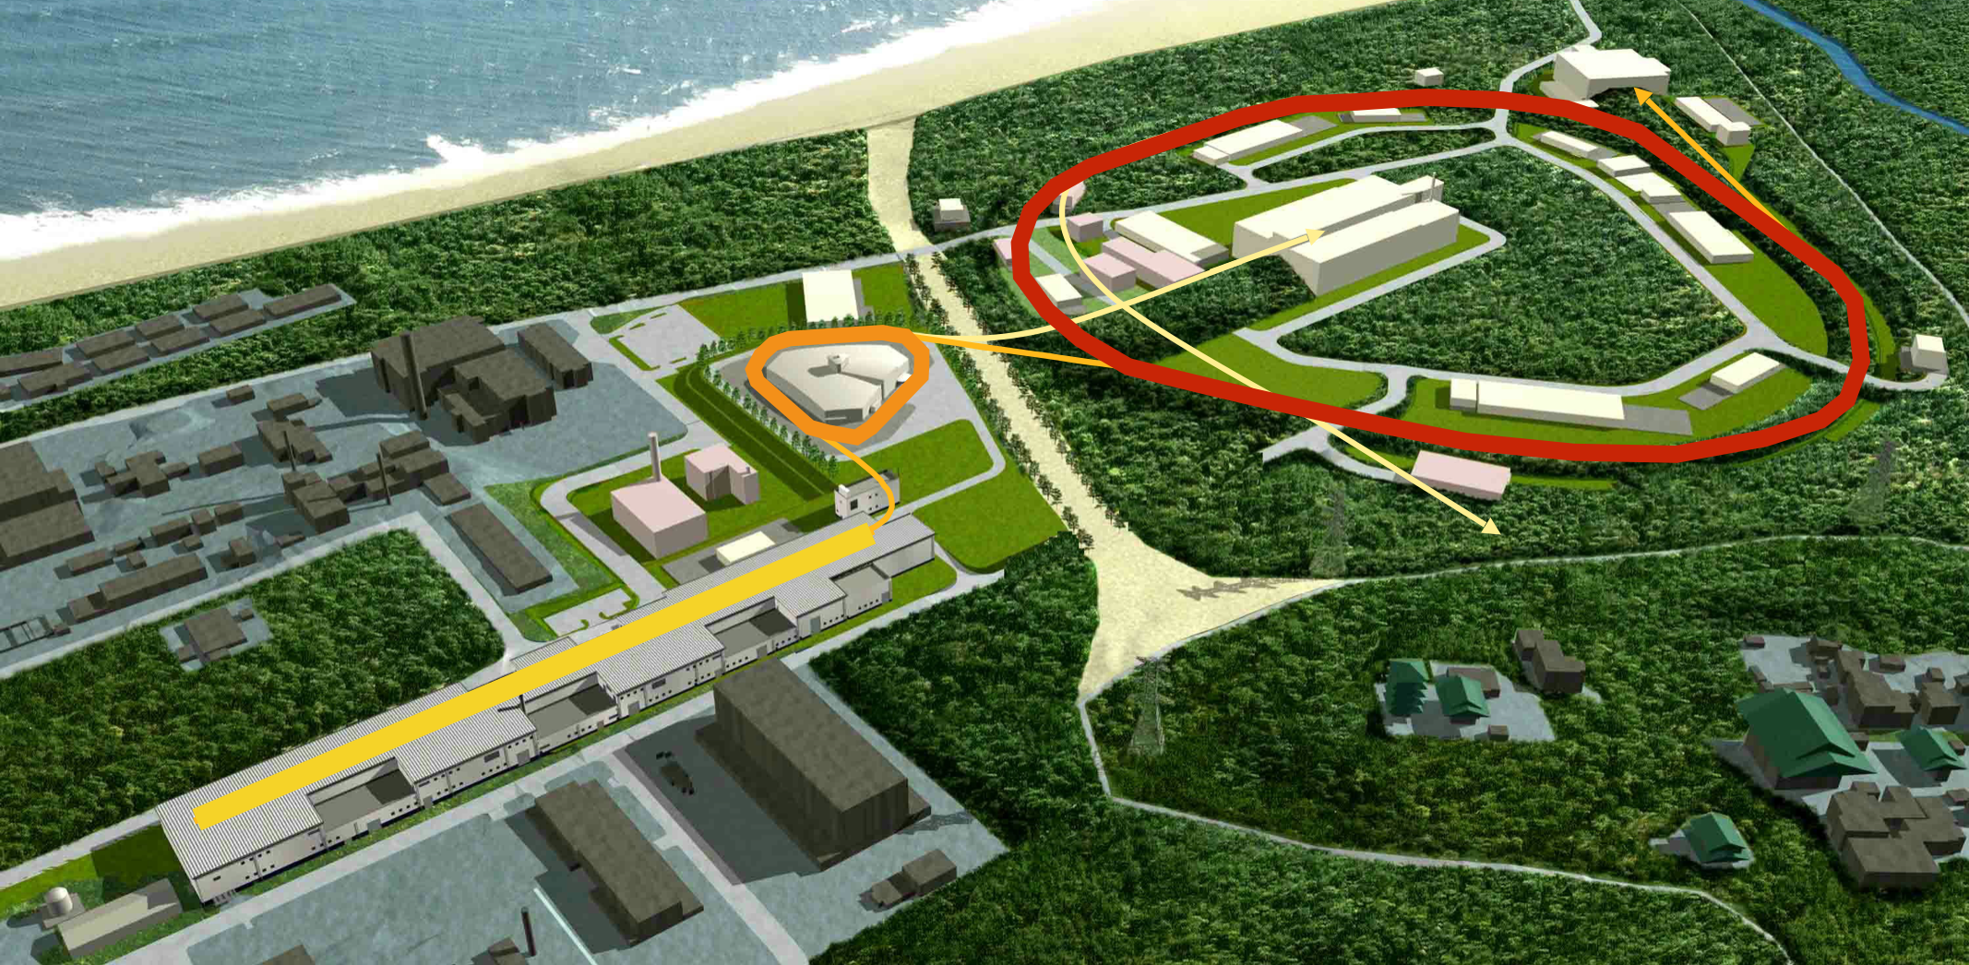
J-PARC
(Japan Proton Accelerator Research Complex)
03/15
Joint Project between KEK and JAEA
High intensity Proton Accelerator with a LINAC and two synchrotrons.
LINAC: 400MeV negative hydrogen (H⁻) with 50mA (25 Hz)
Rapid Cycle Synchrotron (RCS): 3 GeV proton with 1 MW (25 Hz) for material and life science (µ and neutrons).
Main Synchrotron Ring (MR): 30 GeV proton with 830 kW (1.36 s cycle) for ν experiment, 92kW(4.24 s cycle) for Hadron experiment.
J-PARC facility
MR(30GeV)
Hadron 92kW
RCS
(3GeV)
µ,n 1MW
Tokai
LINAC (400MeV)
Neutrino 830kW
Temple & shrine

Slide 4
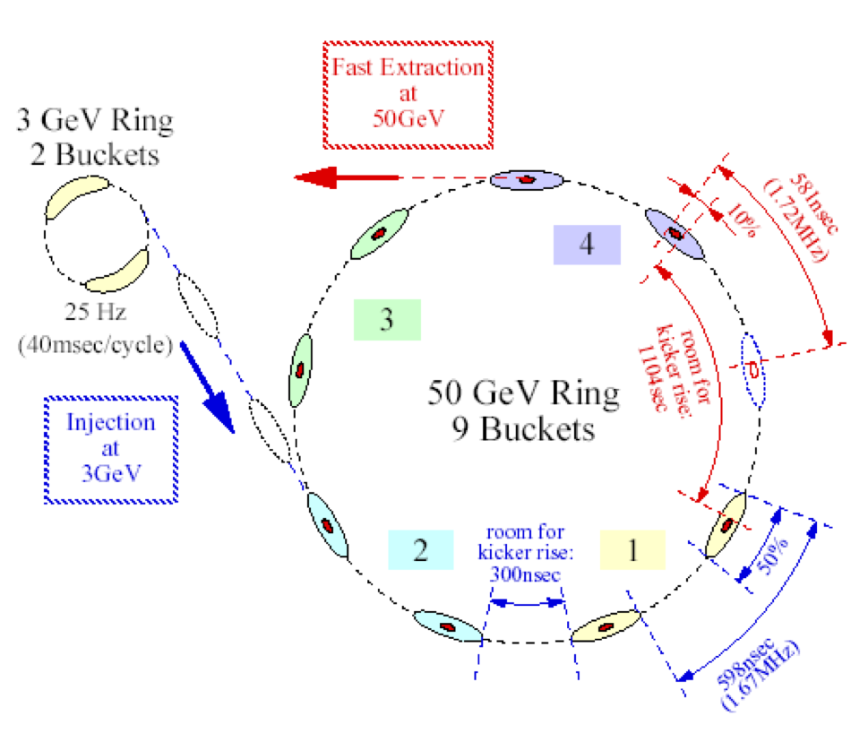
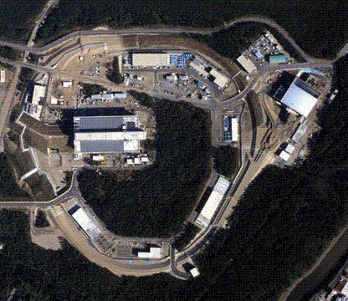
J-PARC 主リング(MR)におけるRF加速
J-PARC Main Ring Synchrotron (MR)
04/15
MR accelerates eight bunches of protons from 3 GeV to 30 GeV.
4 times injection of 2 bunches from RCS
Injection period: 140 ms. Acceleration time: 650 ms.
Two types of beam extraction for experiments.
Fast Extraction (FX): 1 Turn Extraction by Kicker
Slow Extraction (SX): Multi-turn extraction (~ 2s). The beam is debunched by turning the RF off before extraction.
Energy | 3~30GeV
Circumference | 1567.5 m
#Buckets | 9
#bunches | 8
Repetition Cycle | 1.36 s (FX), 4.24 s (SX)
Acceleration time | 650 ms
Extraction
at 30GeV
Hadron Exp.(K,π)
3 GeV RCS
2 Buckets
FX
Neutrino Exp.
30 GeV MR
9 Buckets
SX
MR

Slide 5
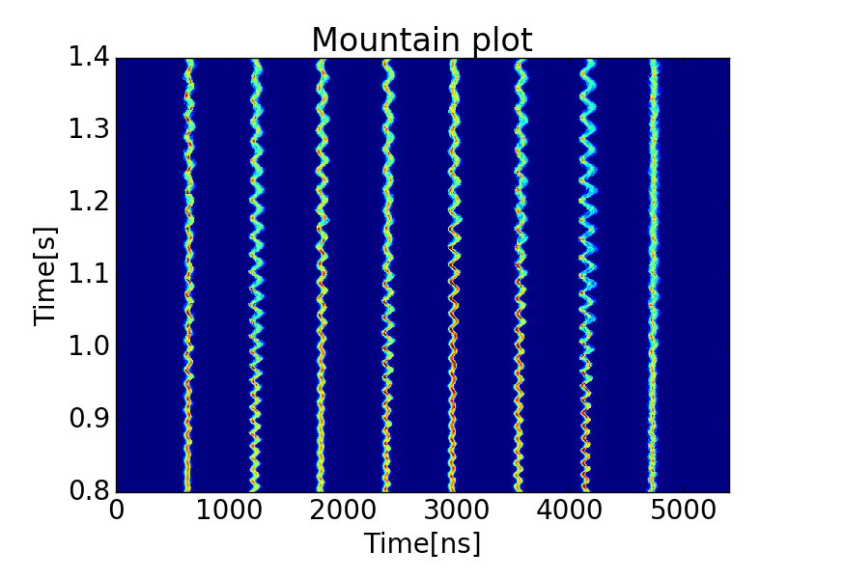
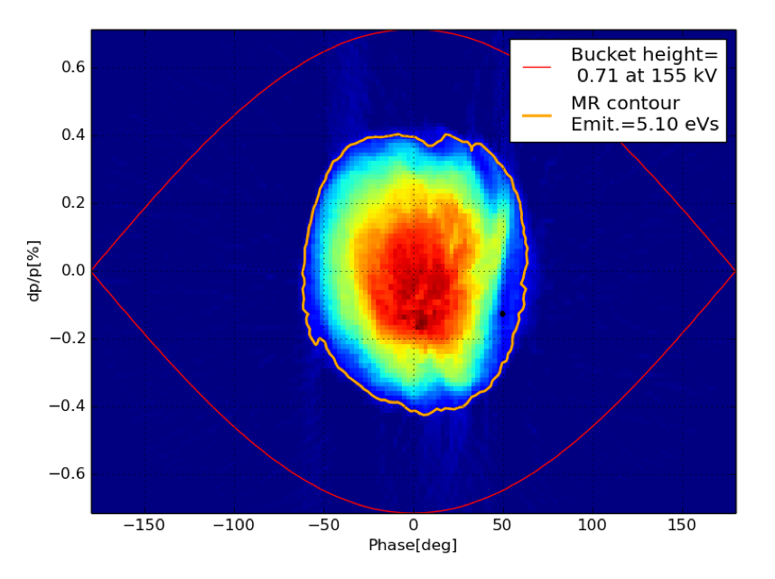
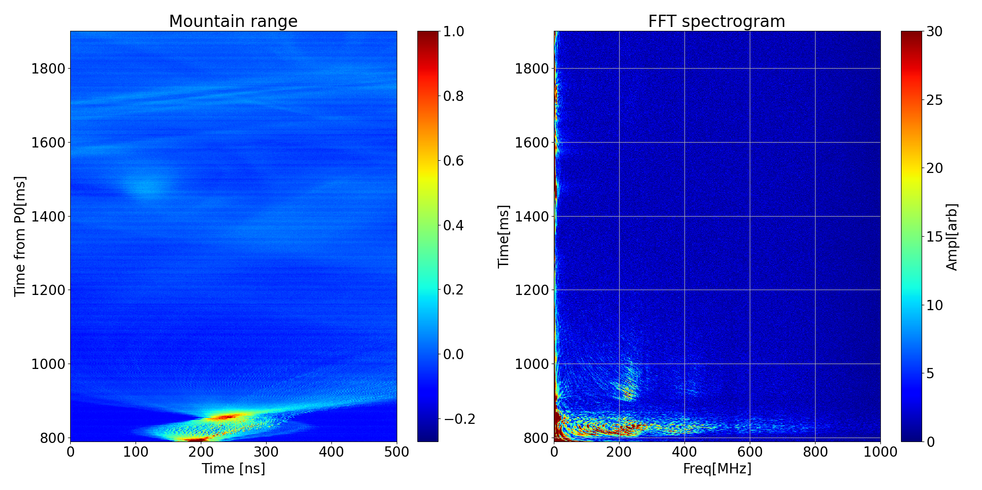
Importance of beam signal monitoring in the J-PARC MR
05/15
The waveforms of the beam signals recorded by the oscilloscopes are essential for monitoring and analyzing the beam's longitudinal properties.
Motion of the beam bunches
Tomography Reconstruction
Spectral Analysis by FFT
Mountain range plot with Coupled Bunch Instability.
Reconstructed distribution by Tomography
Spectrum with microwave instability during debunching process for the Slow Extraction
Typical freq. ~250MHz

Slide 6
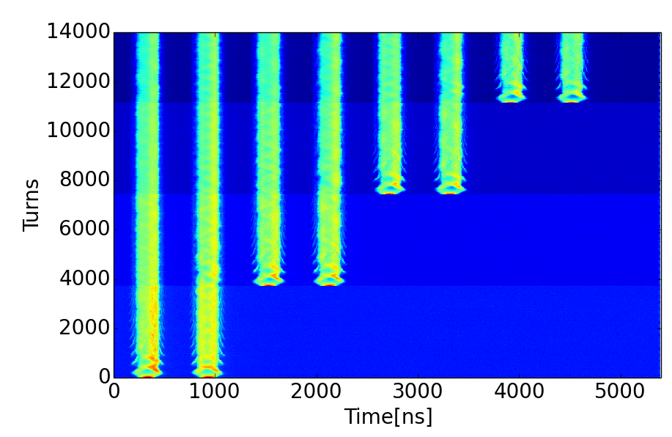
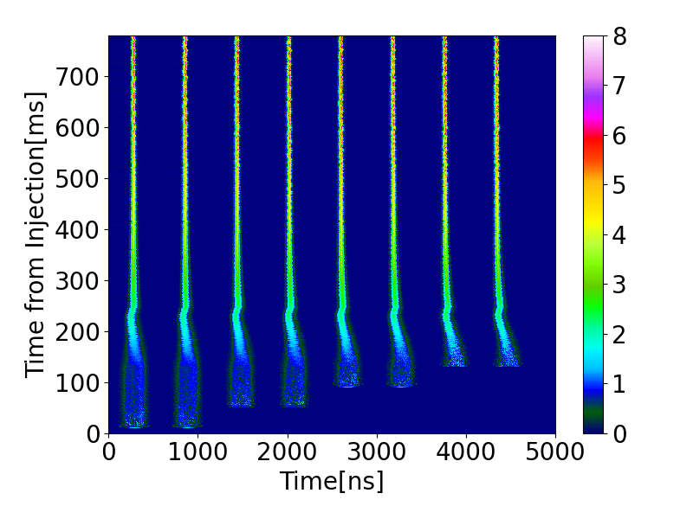
Current situation @J-PARC MR
06/15
Oscilloscopes are used to record the waveform of the beam signal.
Memory on the oscilloscopes: 10~20M samples
Not long enough to store all waveforms for the whole acceleration period.
Two oscilloscopes are used with different recording intervals.
Data readout via VXI11 protocol over Ethernet. Not Fast enough for ~1Hz cycle.
Oscilloscopes cannot acquire and process the data at ~1Hz.
Need FASTER digitizer!!!
Oscilloscope for monitoring Injection period
Oscilloscope for monitoring whole the acceleration
5M Sample (~20ms) /Injection
250MSa/s
Record waveform every turn
500MSa/s
Record waveform every 1ms

Slide 7
Motivation for new digitizer
07/15
Use a single-digitizer to record the entire acceleration period.
Record and analyze the waveform of the beam signal for every shot.
Post-mortem analysis
Online Monitoring
FFT or bunch shape analysis for monitoring instabilities.
Real-time phase space reconstruction.
Use the analysis result as input to machine learning(ML)
Use ML to perform slow control for the LLRF system in the future.

Slide 8
Requirement for new digitizer
08/15
Required specs.
Sampling speed faster than 500MSa/s.
Analog bandwidth >~500MHz for the spectral analysis.
Memory: 1~2 GB to store the waveform for the whole acceleration period.
Readout interface faster than VXI11 via Ethernet.
A compact and stand-alone system is preferred.
A high-speed MTCA digitizer AMC with a small MTCA chassis as a solution!

Slide 9
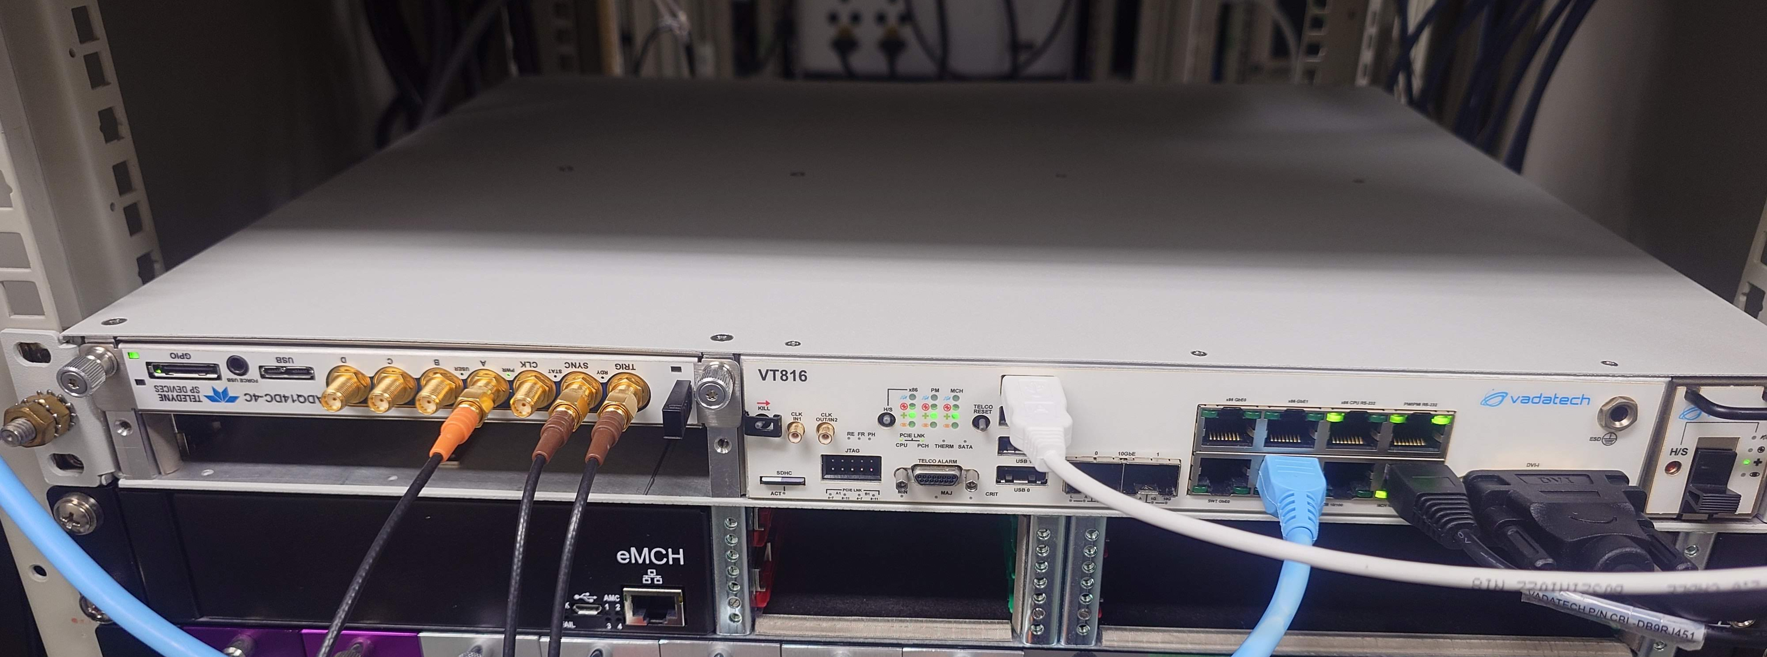
MTCA.4-based high-speed digitizer system for J-PARC MR
09/15
1U MTCA chassis with high-speed digitizer AMC module.
Digitizer: Teledyne SP Device ADQ14
14bit,1GSa/s, 700MHzBW, 4ch input, 2GB memory.
Vadatech MTCA chassis VT816 (Ubuntu Linux)
Embedded MCH with CPU (Intel Xeon E3-1125)
Fast readout via PCIexpress bus in the MTCA backplane.

Slide 10
Data acquisition method
10/15
Information required for the analysis: Waveform slice for each turn.
The easiest way for acquisition: Record a single long waveform using the beam cycle start timing as a trigger for the acquisition.
Issue: Offline slice reconstruction from a single long waveform (>1M samples) requires the revolution clock data and a long time to process.
Solution in the case of the J-PARC MR: Acquisition with fixed number of samples using the revolution clock as a trigger.
Fixed sample acquisition is valid since the change of revolution frequency of the MR is only 3% and the MR has one empty bucket.
The shortest revolution period is chosen as a record length to ensure the recording for all turns.
Waveform slices for each turn are stored in the memory as an array of waveforms with a fixed number of samples. Easy to reconstruct.

Slide 11
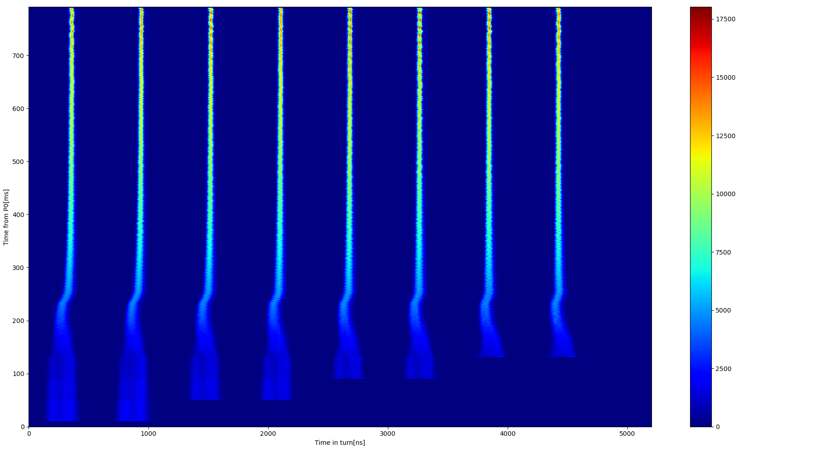
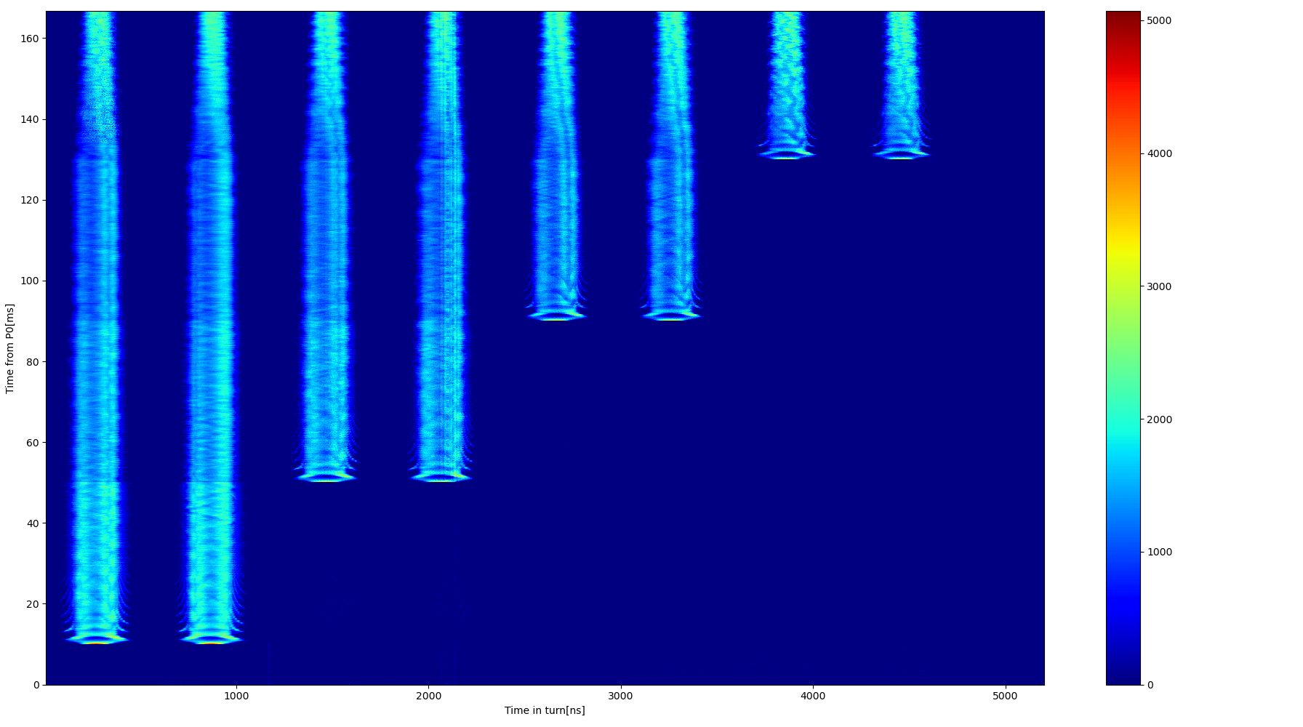
New digitizer in operation at J-PARC MR
11/15
The new digitizer is installed in the J-PARC MR and has been operating since November 2024.
Successfully recorded the waveform of beam signal for the whole accelerating period (790ms) with 1GSa/s.
Just started the operation by recording single-shot data by the script.
Automatic data acquisition for continuous beam operation is under preparation.
Data acquisition is fast enough (~1s). Analysis and plotting take time…
Mountain range for the whole acceleration
Mountain range for the injection period(zoom)

Slide 12
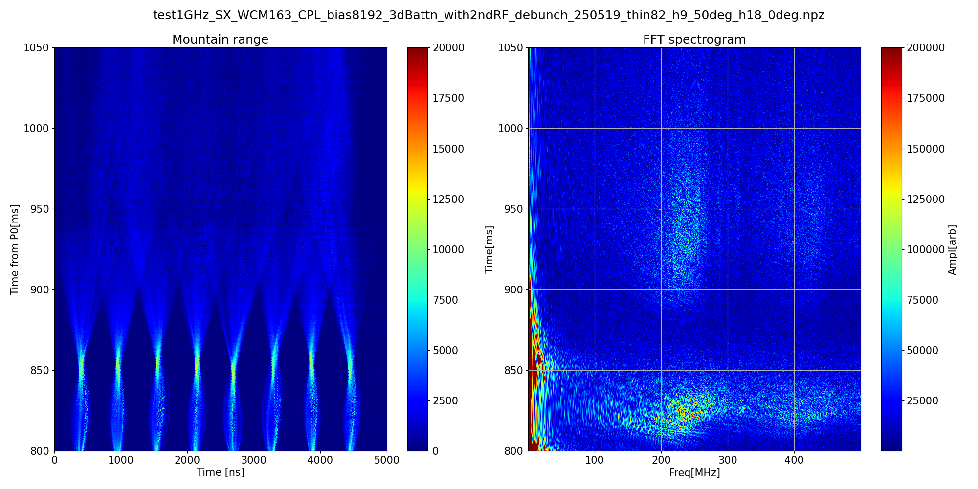
FFT analysis
12/15
With an oscilloscope, the waveform of only one bunch can be recorded with 1GSa/s, and can be analyzed by FFT. Dynamic range: 8-bit.
A new digitizer with a large memory can achieve FFT analysis with eight bunches for the whole acceleration period.
Better sensitivity can be achieved thanks to the wider dynamic range(14-bit).
Spectrum for each turn during debunching process (recorded by ADQ14)

Slide 13
Future Prospect
13/15
Automatic data acquisition and integration with EPICS.
Readout Performance Measurement.
Faster analysis with a GPU
Online analysis, such as FFT and Tomography reconstruction.
Utilize machine learning with a GPU for even faster analysis.
Peer-to-peer data transfer to the GPU.
ADQ14 supports direct memory transfer to the GPU.
Use the online/offline analysis result as input for machine learning to perform slow control of LLRF in the future.

Slide 14
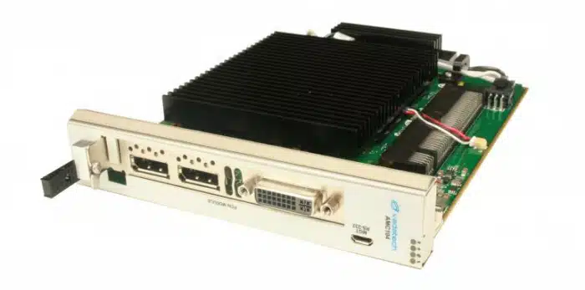
GPU on MTCA?
14/15
If we can have GPU modules in the MTCA system, it will give higher computing performance….but.
No AMC module with a GPU is currently available.
Is it due to the available power per AMC? (80W)
Three possibilities.
Installing a GPU on the AMC carrier, such as Vadatech AMC104.
Some GPU cards can operate within 80W limit.
NVIDIA RTX A1000 (50W), L4(72W)
No confirmation for peer-to-peer transfer…
Connect the PCI-Express bus of the MTCA backplane to the external PC with a high-performance GPU.
Purchase PCI-Ex version of digitizer.
Vadatech AMC104

Slide 15
Summary
15/15
Waveforms recorded by oscilloscopes or digitizers are essential for monitoring the longitudinal property of the beam.
A high-speed digitizer with a large memory is required for the J-PARC MR to record the waveform for the whole acceleration period.
The Teledyne SPD ADQ14 AMC, paired with the Vadatech VT816 chassis, is chosen as the new digitizer platform.
The new digitizer started operation in November 2024.
Integration with GPU is under consideration.

